Slide 1
Using QT Creator/ GUI Design
Harriet Brown
(She/Her)

Slide 2
Exploring QT Design
Creating a UI.
It’s basically the same way you would do it with python or c++ except simpler and cleaner.
Putting in the layout is easy, but functionality has to go in separately.

Slide 3
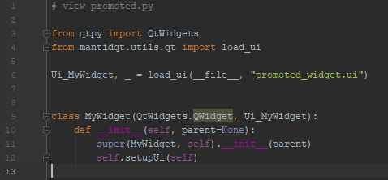
Using your UI in a python script

Slide 4
Signals and Slots
self.view. close_btn. clicked. connect(self.view.close)
QWidget. QPushButton. Signal. connect(QWidget.slot)
self.view. input_text. textEdited. connect(print)
QWidget. QLineEdit. Signal. connect(function)
Some Signals emit with an output, and can be connected to a function

Slide 5
Promoted Widgets
Good for when you need to use a complicated widget a lot.
More modular design.
Each individual widget can be simpler.
Promoted widgets can be used in different projects.

Slide 6
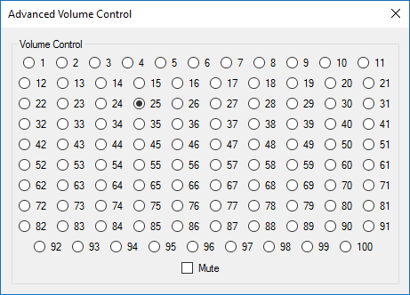
Dos and don’ts of GUI design
What does this button do?
Is there any way for me to…?
Where is the ... Button?
F-ing tabs keep popping off on a hair trigger.
But the button says “foo”, why does it “bar”?
Why is there even an option for this?

